Slide 1
Konsol

Slide 2
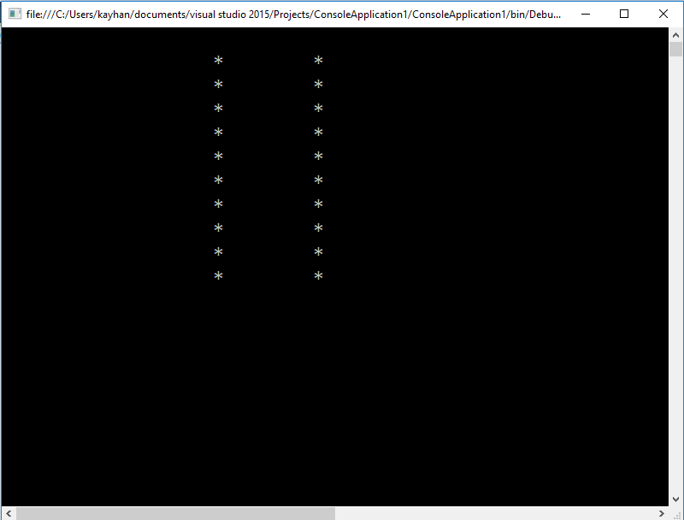
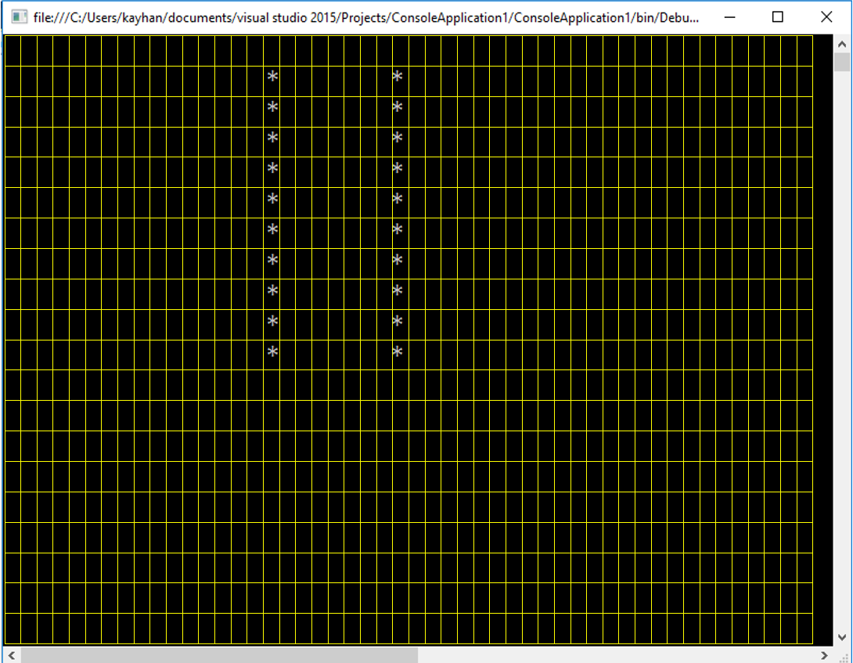
X
Y

Slide 3
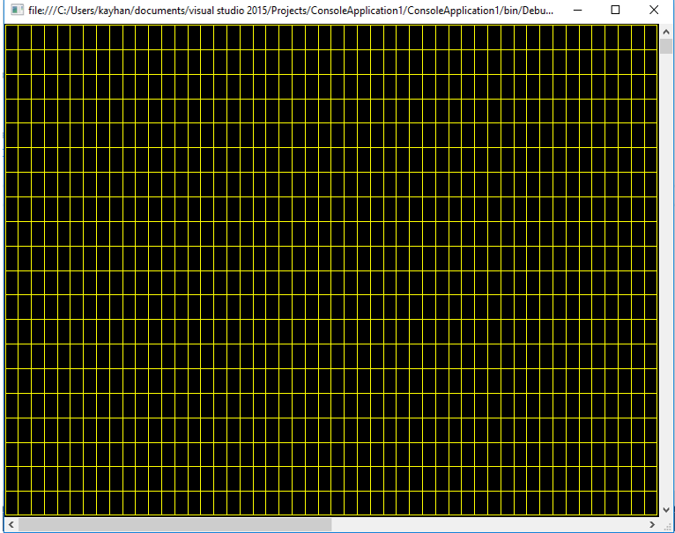
0,0
1,0
2,0
3,0
10,10
Console.Write("*");
*
*
Console.Write("*");
*
Console.Write("*");
Console.SetCursorPosition(10, 10);
Console.Write("*");
*
*
Console.Write("*");
Console.SetCursorPosition(5, 5);
*
Console.Write("*");
*
Console.WriteLine("*");

Slide 4
*
*
*
*
*
*
*
*
*
*
Console.SetCursorPosition(5, 5);
for(int i=0;i<10;i++)
{
}
Console.SetCursorPosition(i+5, i+5);
Console.SetCursorPosition(i+5, 5);
*
*
*
*
*
*
*
*
*
*
*
*
Console.Write("*");
*
*
*
*
*
*
*
*
*

Slide 5
ÖRNEK UYGULAMALAR
https://www.youtube.com/playlist?list=PLIM5iw4GHbNV6u1EGlELeb4nULncmLIz9

